Slide 1
BIG DATA
Hands on AWS

Slide 2
Identity and Access Management
Identity and Access Management (IAM)
Web service that controls fine-grained access to AWS resources
IAM controls who is authenticated and authorized to use resources
IAM user
Unique identity recognized by AWS services and applications
Similar to user in an operating system like Windows or UNIX

Slide 3
Identity and Access Management
IAM role
Set of policies for making AWS service requests
Trusted entities (e.g., such as IAM users) assume roles
Delegate access with defined permissions to trusted entities
There is no limit to the number of IAM roles a user can assume
User vs role
User has permanent long-term credentials and is used to directly interact with AWS services
Role does not have credentials and cannot make direct requests to AWS services
Roles are assumed by authorized entities, such as IAM users

Slide 4
Identity and Access Management
Alice (i.e., an IAM user) is a firewoman
She is the same person with or without her turnout gear
As a firewoman (i.e., a role)
If she speeds to a house fire and passes a police officer, he isn't going to give her a ticket
In her role as a firewoman, she is allowed to speed to the house fire
As a private citizen (i.e., another role)
When she is off duty, if she speeds past that same police officer, he's going to give her a ticket
In her role as a private citizen, she is not allowed to speed

Slide 5
AWS
Amazon Web Services (AWS) is a public-cloud platform
Services can be accessed in multiple ways
Web GUI: intuitive point and click access without any programming
Intuitive interfaces is part of the attraction of cloud services
Tedious if the same actions must be performed repeatedly
(REST) Application programming interface (API)
Permits requests to be transmitted via Hypertext Transfer Protocol (HTTPS)
Software development kits (SDKs) that you install on your computer
Access from programming languages such as Python, Java, etc.

Slide 6
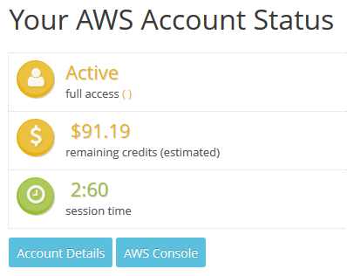
AWS Web console
We use the AWS Educate program
Login with the provided account
You got 150$ to work on AWS services
Provisioned services charge even if not used
https://www.awseducate.com/signin/SiteLogin

Slide 7
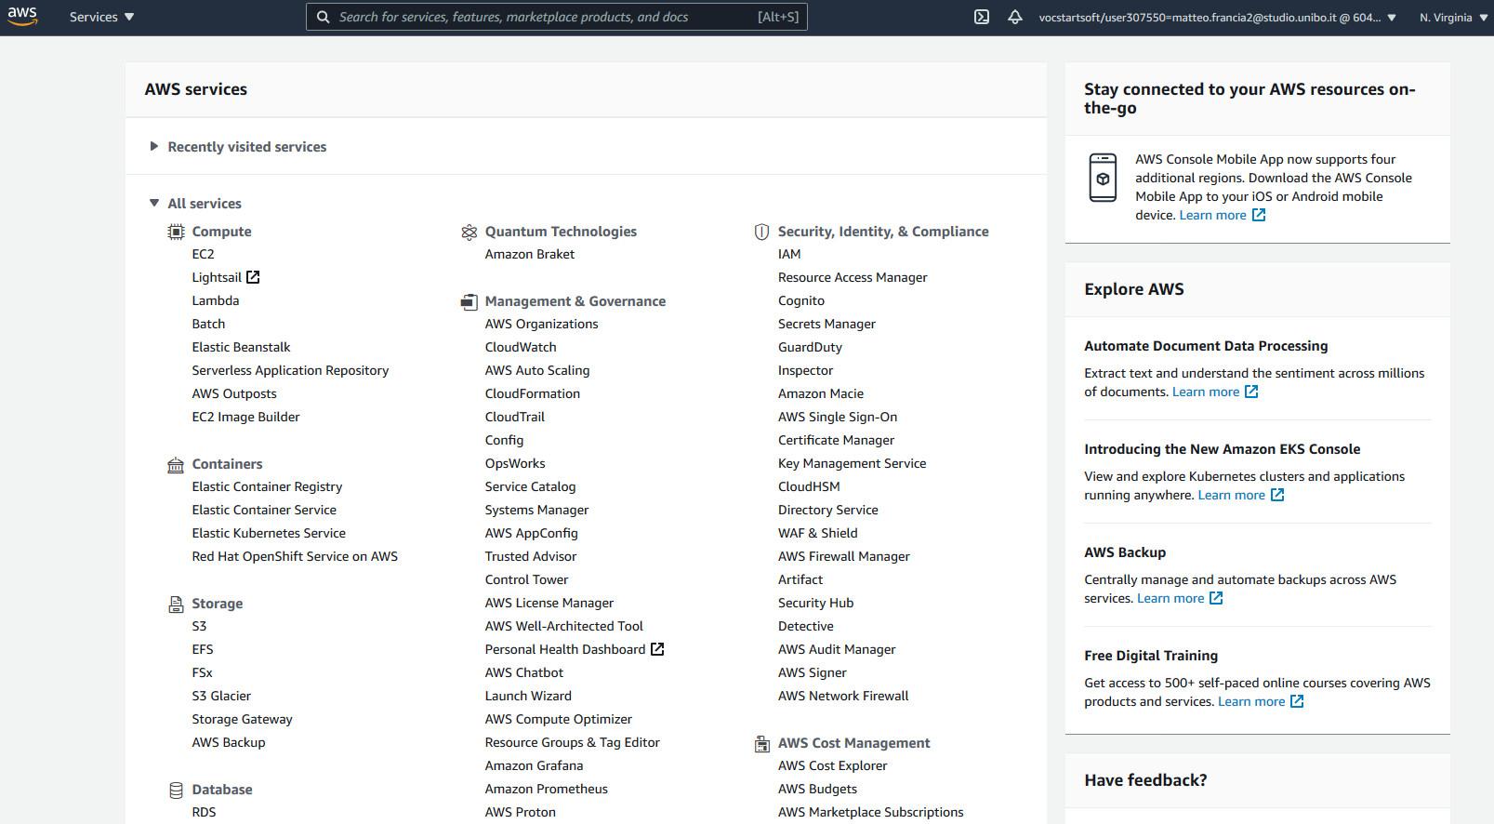
AWS Web console

Slide 8
AWS CLI
CLI interface
Necessary to install the CLI (version 2)
See https://docs.aws.amazon.com/cli/latest/userguide/install-cliv2.html
Synopsis
********
aws [options] <command> <subcommand> [parameters]
Description
***********
A unified tool to manage your AWS services.
https://docs.aws.amazon.com/cli/latest/userguide/install-cliv2-linux.html

Slide 9
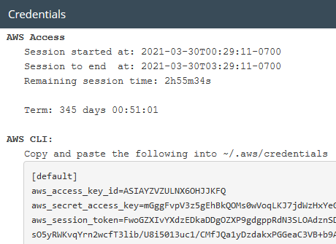
AWS CLI
CLI needs credentials to work
Go back to AWS Educate
Click on “Account Details”
Copy the content into the file ~/.aws/credentials
Henceforth, we assume that you have set up the credentials file
Credentials expire after some time; you need a manually refresh
………………
………………
………………

Slide 10
AWS CLI
Run `aws configure`
Confirm AWS Access Key ID (press enter)
Confirm AWS Secret Access Key (press enter)
Set Default region name to `us-east-1`
Set Default output format to `json`
It is also possible to configure an AWS profile
A (named) profile is a collection of settings and credentials
If profile is specified, its settings and credentials are used to run a command
When no profile is explicitly referenced, use `default`
We stick to `default`

Slide 11
Object storage: S3
Create S3 bucket, the following rules apply for naming buckets
Must be between 3 and 63 characters long
Can consist only of lowercase letters, numbers, dots (.), and hyphens (-)
Must be unique within a partition (i.e., a group of regions)
$ git clone https://github.com/w4bo/bigdata-aws/
$ cd bigdata-aws/lab01-lambda
$ aws s3api create-bucket --bucket aws-bucket-bigdata2021
$ aws s3 cp datasets/inferno.txt s3://aws-bucket-bigdata2021/inferno.txt
$ aws s3api list-objects --bucket aws-bucket-bigdata2021
https://s3.console.aws.amazon.com/s3/home?region=us-east-1#

Slide 12
BIG DATA
Data pipelines on AWS Lambda

Slide 13
Requirements
To start this lecture, you need to
Activate your AWS Educate account
Either
Install the necessary software
git
IntelliJ IDEA (with AWS Toolkit and Scala plugins)
python
java 1.8
Docker
AWS CLI, AWS SAM CLI
Be able to download and run the VM

Slide 14
AWS SAM CLI
Serverless Application Model is a framework to build serverless applications
A serverless application is a combination of Lambda functions, event sources, etc.
Install AWS SAM CLI (on Linux)
sudo group add docker
sudo usermod –aG docker $USER
newgrp docker
sudo chmod 666 /var/run/docker.sock
wget https://github.com/aws/aws-sam-cli/releases/latest/download/aws-sam-cli-linux-x86_64.zip
unzip aws-sam-cli-linux-x86_64.zip -d sam-installation
sudo ./sam-installation/install
sam --version
https://docs.aws.amazon.com/serverless-application-model/latest/developerguide/serverless-sam-cli-install.html

Slide 15
AWS services
AWS Educate (and AWS console)
https://aws.amazon.com/it/education/awseducate/
https://console.aws.amazon.com/console/home?region=us-east-1
IAM (authentication)
https://docs.aws.amazon.com/IAM/latest/UserGuide/iam-ug.pdf
SDK (software API)
https://docs.aws.amazon.com/sdk-for-java/latest/developer-guide/home.html
Lambda (serverless computing and processing)
https://docs.aws.amazon.com/lambda/latest/dg/getting-started.html
https://console.aws.amazon.com/lambda/home?region=us-east-1#/functions
DynamoDB (key-value database)
https://docs.aws.amazon.com/amazondynamodb/latest/developerguide/Introduction
S3 (object storage)
https://s3.console.aws.amazon.com/s3/home?region=us-east-1

Slide 16
Case study
Given a dataset of sales per customer
find the products frequently bought together
Dataset sample
%%%%%%%%%%%%%%
[ { customerName: Alice, products: [Pizza, Beer, Diaper] },
{ customerName: Bob, products: [Pizza, Beer, Diaper] },
{ customerName: Charlie, products: [Pizza, Cola] } ]

Slide 17
Case study
The pipeline involves a single transformation
A classic mining problem, which one?
Dataset
?
Output

Slide 18
Frequent itemset mining
Dataset sample
%%%%%%%%%%%%%%
[[Pizza, Beer, Diaper],
[Pizza, Beer, Diaper],
[Pizza, Cola]]
Find sets of items (i.e., itemsets) frequently appearing together
Item: a product
Itemset: a set of products
Frequently: support above threshold
Support: number of clients buying a set of products
Complexity: O(2^{|items|})
3
2
2
1
{Pizza}
{Beer}
{Diaper}
{Cola}
2
2
1
{Pizza,Beer}
{Pizza,Diaper}
…
{Pizza,Cola}
2
{Pizza,Diaper,Beer}

Slide 19

Case study
$$FIM: List\left[List\left[String\right]\right]→List[Set\left[String\right]]$$
FIM requires a list of lists as input, but we have nested JSON objects
We need a pre-processing step
Finally, we need to store the itemsets in the database
Raw dataset sample
%%%%%%%%%%%%%%
[ { customerName: Alice, products: [Pizza, Beer, Diaper] },
{ customerName: Bob, products: [Pizza, Beer, Diaper] },
{ customerName: Charlie, products: [Pizza, Cola] } ]
Processed dataset sample
%%%%%%%%%%%%%%
[[Pizza, Beer, Diaper],
[Pizza, Beer, Diaper],
[Pizza, Cola]]

Slide 20
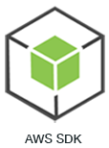
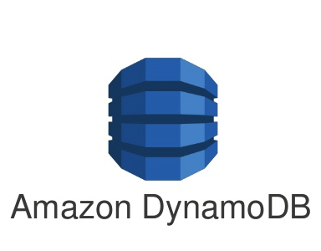



Reference pipeline
Dataset
$λ:$Preprocess
$λ:$FIM
$λ:$StoreDB
Local
AWS cloud

Slide 21
NOSQL storage: DynamoDB
Basic DynamoDB components: tables and items
Tables, collection of (data) items
Items, a group of attributes that is uniquely identifiable
Each table contains zero or more items
No limit to the number of items you can store in a table
Each item in the table has a unique identifier, or primary key
E.g., in the table `people`, each item represents a `person`
The primary key consists of one attribute (`fiscalCode`)

Slide 22
NOSQL storage: DynamoDB
Attributes
A data element that is not broken down any further
E.g., an item in the `people` table contains attributes `fiscalCode` and `lastName`
Most of the attributes are scalar (have only one value)
Some of the items have a nested attribute (`address`) up to 32 levels deep
Schemaless
Other than the primary key, a table is schemaless
Neither the attributes nor their data types need to be defined beforehand
Each item can have its own distinct attributes

Slide 23
NOSQL storage: DynamoDB
Primary Key
To create a table, you must specify the primary key of the table
No two items can have the same key
Two types of primary keys
Partition key: a simple primary key composed of one attribute (partition key)
Keys are inputs to an internal hash function
The hash function determines the physical partition in which the item will be stored
E.g., access any item in the `people` table directly by providing the `fiscalCode`
Composite primary key: partition key and sort key (two attributes)
First attribute is the partition key
Second attribute is the sort key
Items in same partition key value are stored together and sorted by sort key

Slide 24
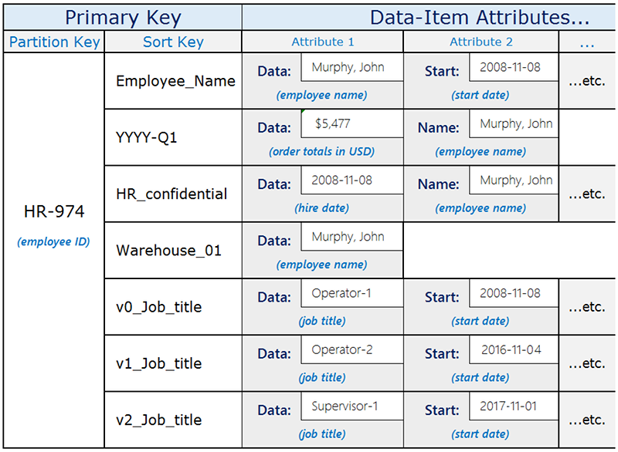
NOSQL storage: DynamoDB
https://docs.aws.amazon.com/amazondynamodb/latest/developerguide/bp-gsi-overloading.html

Slide 25
NOSQL storage: DynamoDB
Secondary Indexes
One or more secondary indexes per table
Indexes are automatically maintained on add, update, or delete
Query data using an alternate key (additionally to queries against primary key)
Two types of indexes
Global secondary has partition and sort keys different from those on table
Local secondary has the same partition key but a different sort key
Each table has a limited quota of 20 global and 5 local indexes
How do we shape the schema?
https://cloud.google.com/bigtable/docs/schema-design

Slide 26
NOSQL storage: DynamoDB
Create a table `frequent-sales` with a composite key
`dataset`: String
`timestamp`: String
$ aws dynamodb create-table \
--table-name frequent-sales \
--attribute-definitions AttributeName=dataset,AttributeType=S AttributeName=timestamp,AttributeType=S \
--key-schema AttributeName=dataset,KeyType=HASH AttributeName=timestamp,KeyType=RANGE \
--provisioned-throughput ReadCapacityUnits=1,WriteCapacityUnits=1
$ aws dynamodb list-tables
$ aws dynamodb delete-table --table-name frequent-sales

Slide 27
NOSQL storage: DynamoDB
Reading data from DynamoDB might not reflect the results of a recent write
Eventually Consistent Reads (default)
Response might include stale data
After short time, the response should return the latest data
Strongly Consistent Reads
Response includes the most up-to-date data
A strongly consistent read might not be available if there is a network delay or outage
In this case, DynamoDB may return a server error (HTTP 500)
Strongly consistent reads may have higher latency than eventually consistent reads
Strongly consistent reads are not supported on global secondary indexes

Slide 28
NOSQL storage: DynamoDB
Provisioned mode: specify the #reads and #writes per second
You have predictable application traffic or traffic ramps gradually
You can forecast capacity requirements to control costs
One read capacity unit
One strongly consistent read per second, two eventually consistent reads per second
RCUs also depend on the item size (a read is up to 4 KB in size), if item size is 8 KB
2 RCUs to sustain one strongly consistent read per second
1 RCU if you choose eventually consistent reads
One write capacity unit represents one write per second for an item up to 1 KB in size

Slide 29
NOSQL storage: DynamoDB
Put a new item and get it back
$ aws dynamodb put-item --table-name frequent-sales --item '{"dataset": {"S": "sales"}, "timestamp": {"S": "1611226870"}, "bar": {"S": "foobar"}}'
$ aws dynamodb query --table-name frequent-sales --key-condition-expression "dataset = :n" --expression-attribute-values '{":n":{"S":"sales"}}'

Slide 30
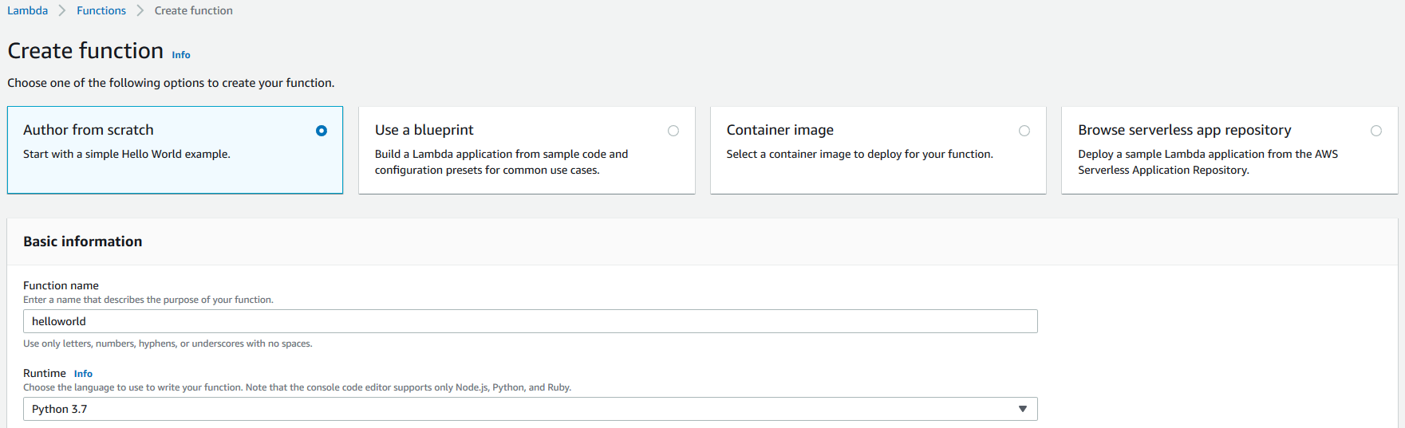
Lambda: create a function
https://console.aws.amazon.com/lambda/home?region=us-east-1#/functions

Slide 31
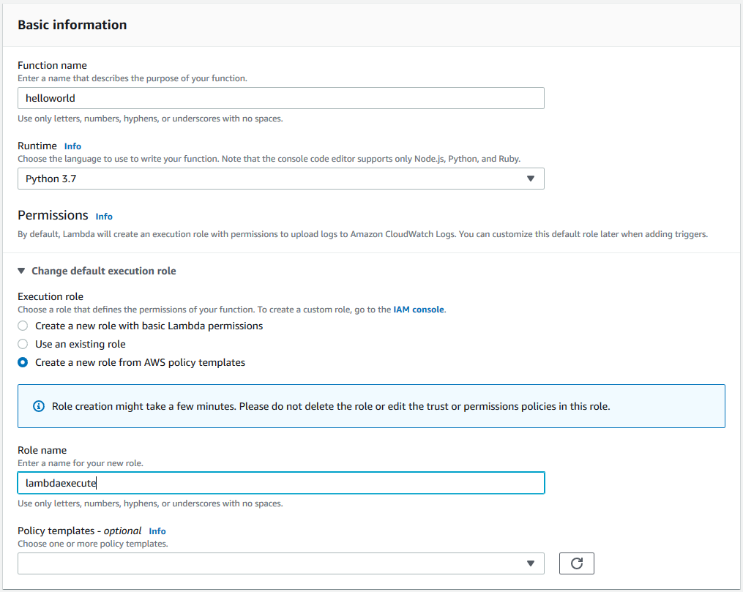
Lambda: attaching a role

Slide 32
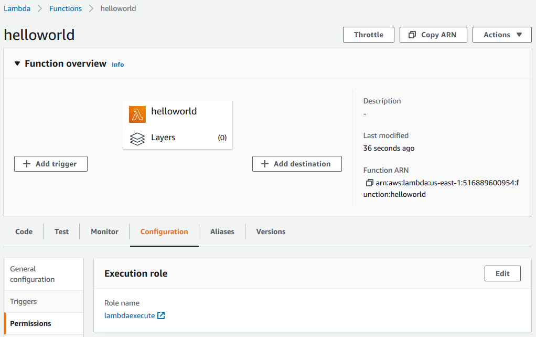
Lambda: attaching a role

Slide 33
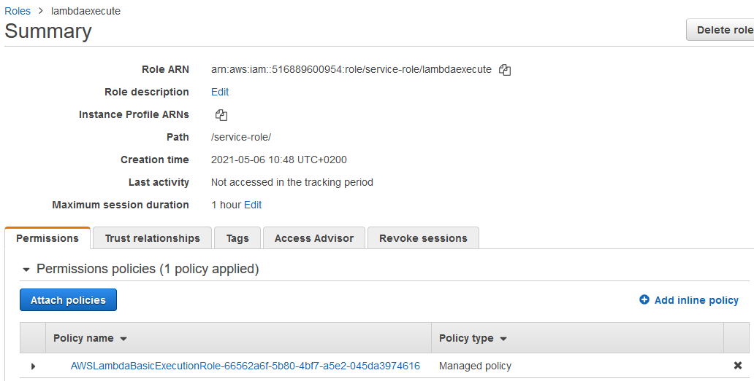
Lambda: attaching a role

Slide 34
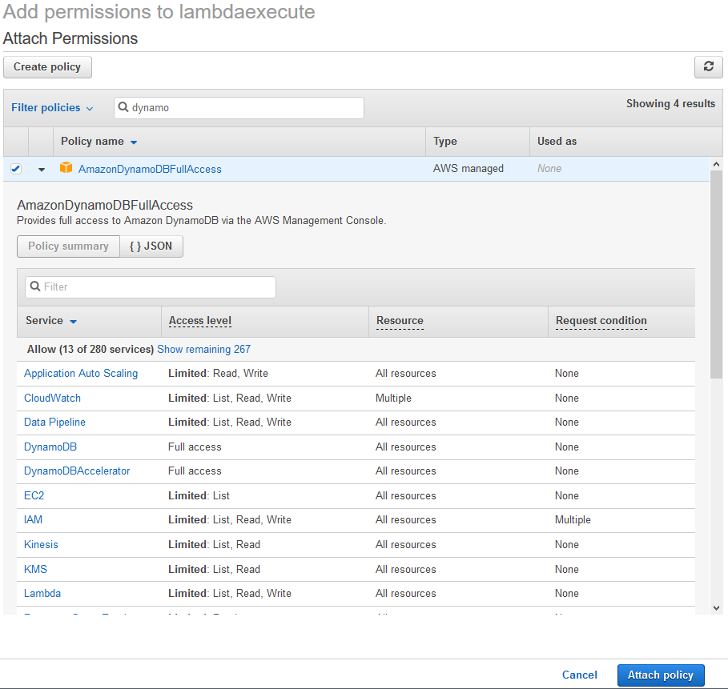
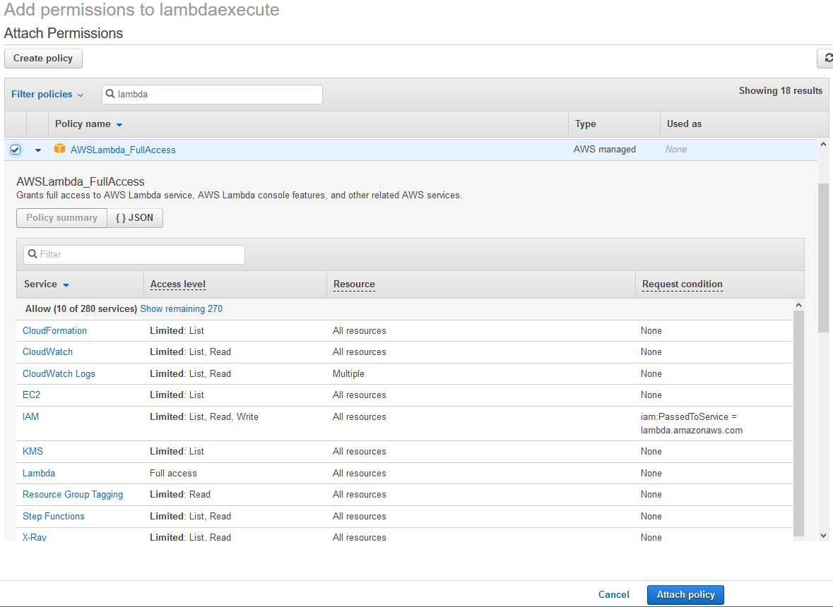
Lambda: attaching a role

Slide 35
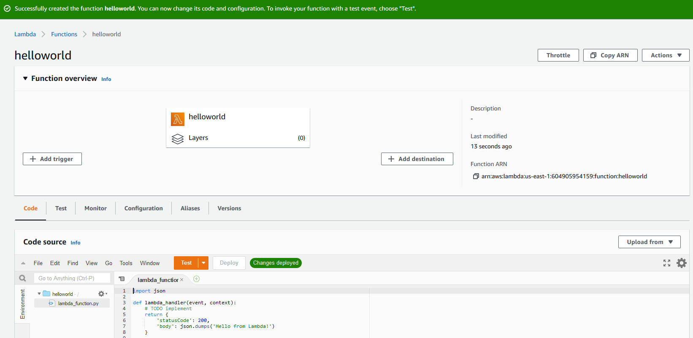
Lambda: create a function
https://console.aws.amazon.com/lambda/home?region=us-east-1#/functions

Slide 36
Lambda: create a function
Manually creating the functions is cumbersome
We must copy and paste code
No automatic testing
No debugging
No IDE support (and not all languages are supported)
Switch to IntelliJ IDEA + AWS Toolkit

Slide 37
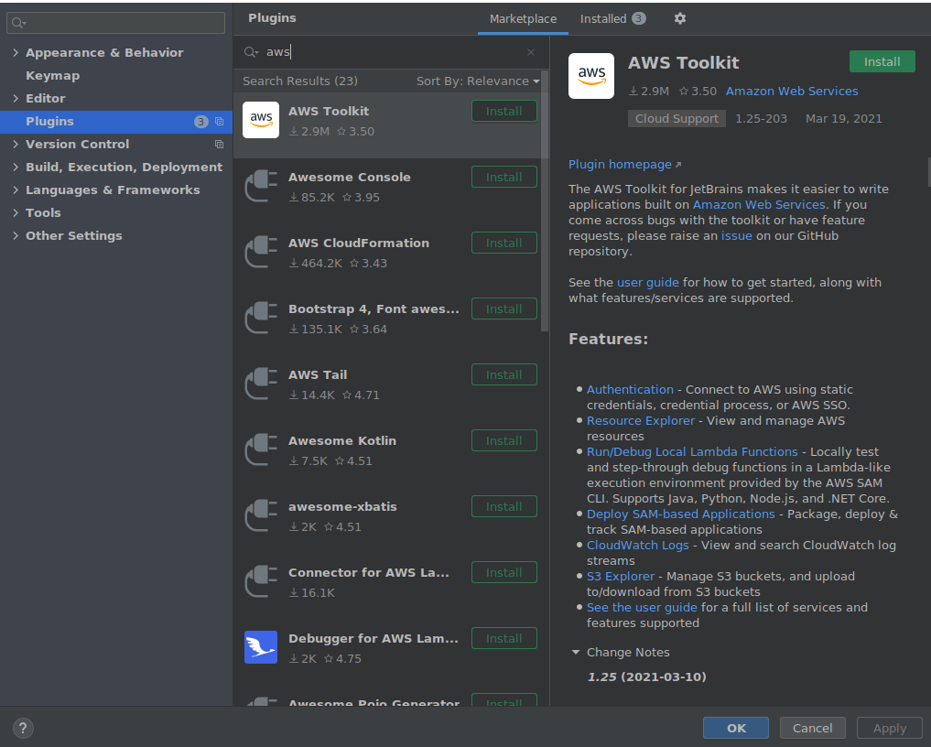
AWS Toolkit
Get the latest IntelliJ IDEA
Install the `AWS Toolkit`
Copy the credentials cp ~/.aws/credentials ~/.aws/config
Clone the repo git clone https://github.com/w4bo/bigdata-aws/
Import `lab01-lambda` as a Gradle project
Verify that the project builds ./gradlew

Slide 38
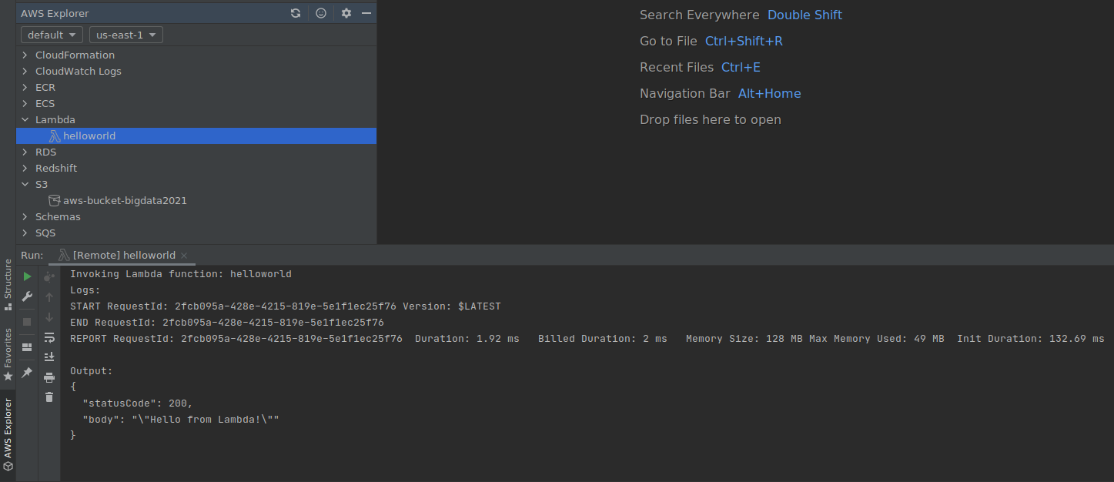
AWS Toolkit
Click on `AWS Explorer`
You can see the `helloworld` function
Plus `CloudWatch Logs` and `S3`

Slide 39
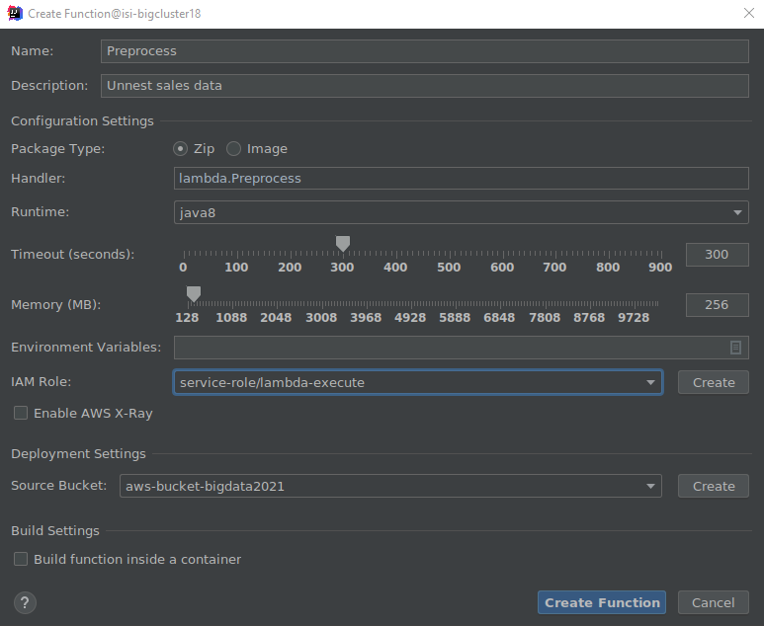
AWS Toolkit
Test the existing code locally
With Gradle
Or with local Lambda execution
Deploy a new Lambda function from the existing code
Right click on AWS Explorer > Lambda
Select `Create new AWS Lambda…`
Populate the settings
`Create the function`
https://aws.amazon.com/lambda/pricing/

Slide 40
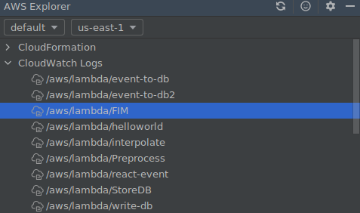
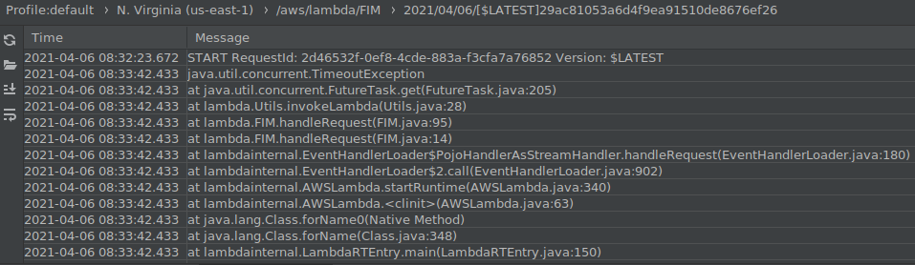
AWS Toolkit
Check the log for errors and pricing
AWS Toolkit > CloudWatch Logs
Double click on the function name
Double click on the log entry

Slide 41
Data pipeline
Deploy and execute the HelloWorld.java lambda function
Given the created storage: S3 and DynamoDB
Deploy the function `FIM`
Deploy the function `Preprocess`
Run ReadDataset.java
Check that the table `frequent-sales` has the FIs for the dataset `sales`
Some hints
Function names are case sensitive
Some function need more than 128MB of memory
Behold! The higher the RAM, the higher the costs

Slide 42
BIG DATA
Amazon EMR

Slide 43
EC2
AWS uses public-key cryptography to secure the login
You can create one using the Amazon EC2 console
Open the Amazon EC2 console at https://console.aws.amazon.com/ec2/
In the navigation pane, choose `Key Pairs`
Choose `Create key pair`
For `Name`, enter a descriptive name for the key pair
For `File format`, choose the format in which to save the private key
OpenSSH, choose `pem` (`chmod 400 my-key-pair.pem`)
PuTTY, choose `ppk`
Choose `Create key pair`
The private key file is automatically downloaded by your browser

Slide 44
Creating the cluster
Choose the frameworks and applications to install
Data process
Submit jobs or queries directly to installed applications
Run steps in the cluster
Submitting jobs
Connect to the master node over a secure connection
Access the interfaces and tools that are available on your cluster

Slide 45
Creating the cluster
Using CLI (command line interface)
This is more pragmatic, but there are many options to explore
Let’s stick to AWS Console
https://console.aws.amazon.com/elasticmapreduce/
aws emr create-cluster \
--name "My First EMR Cluster" \
--release-label emr-5.32.0 \
--applications Name=Spark \
--ec2-attributes KeyName=myEMRKeyPairName \
--instance-type m5.xlarge \
--instance-count 3 \
--use-default-roles

Slide 46
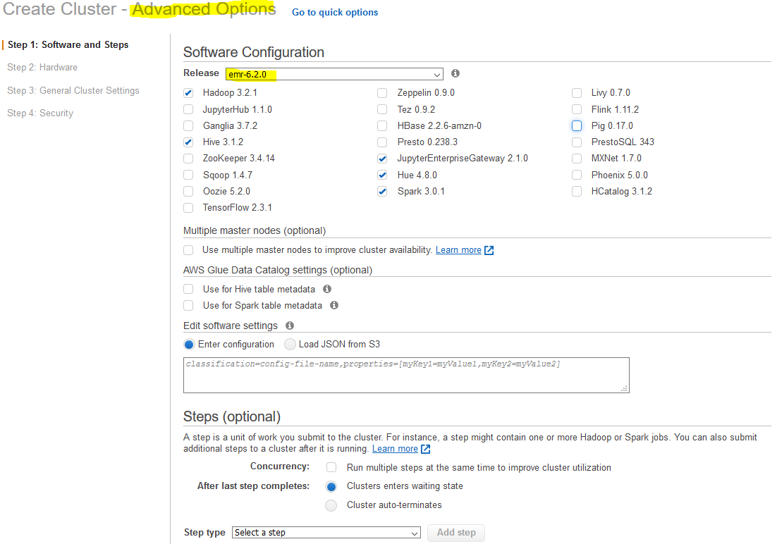
Creating the cluster

Slide 47
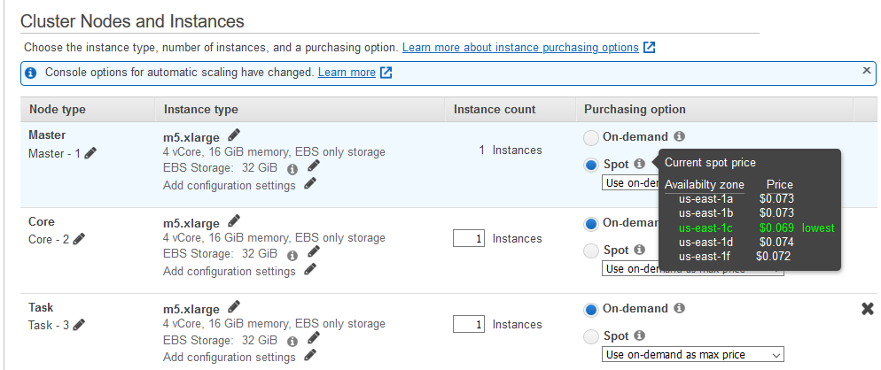
Creating the cluster

Slide 48
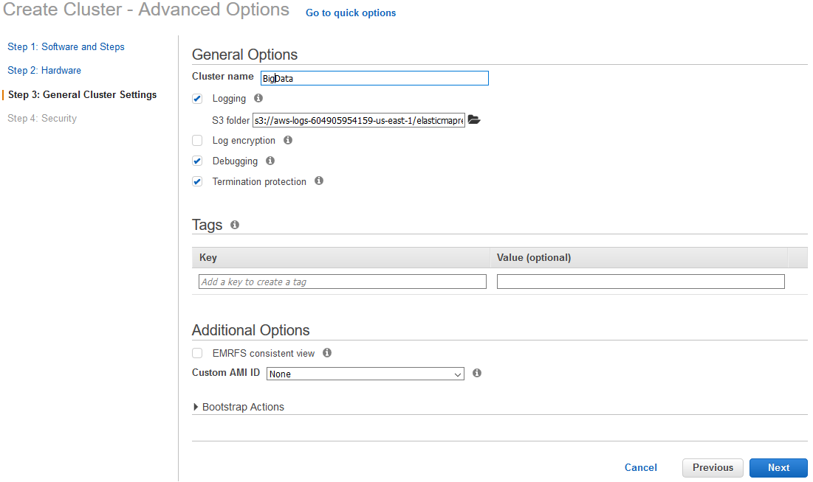
Creating the cluster

Slide 49
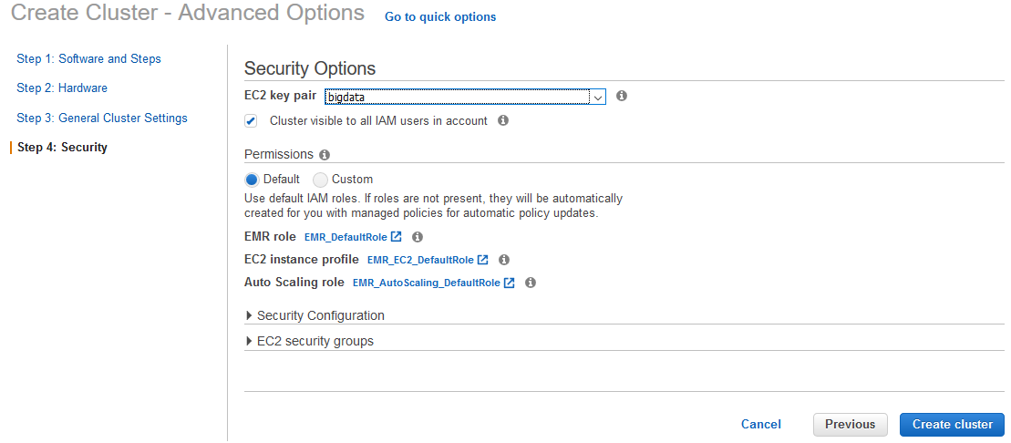
Creating the cluster
Allows EMR to call other AWS Services such as EC2 on your behalf.
Provides access to other AWS services such as S3, DynamoDB from EC2 instances that are launched by EMR.

Slide 50
Creating the cluster
Using CLI (command line interface)
aws emr create-cluster --auto-scaling-role EMR_AutoScaling_DefaultRole --termination-protected --applications Name=Hadoop Name=Hive Name=Hue Name=JupyterEnterpriseGateway Name=Spark --ebs-root-volume-size 10 --ec2-attributes '{"KeyName":"bigdata","InstanceProfile":"EMR_EC2_DefaultRole","SubnetId":"subnet-5fa2f912","EmrManagedSlaveSecurityGroup":"sg-07818b5690a50b3f1","EmrManagedMasterSecurityGroup":"sg-0e2f5550a2cb98f79"}' --service-role EMR_DefaultRole --enable-debugging --release-label emr-6.2.0 --log-uri 's3n://aws-logs-604905954159-us-east-1/elasticmapreduce/' --name 'BigData' --instance-groups '[{"InstanceCount":1,"BidPrice":"OnDemandPrice","EbsConfiguration":{"EbsBlockDeviceConfigs":[{"VolumeSpecification":{"SizeInGB":32,"VolumeType":"gp2"},"VolumesPerInstance":2}]},"InstanceGroupType":"MASTER","InstanceType":"m4.xlarge","Name":"Master - 1"},{"InstanceCount":1,"BidPrice":"OnDemandPrice","EbsConfiguration":{"EbsBlockDeviceConfigs":[{"VolumeSpecification":{"SizeInGB":32,"VolumeType":"gp2"},"VolumesPerInstance":2}]},"InstanceGroupType":"CORE","InstanceType":"m4.xlarge","Name":"Core - 2"}]' --scale-down-behavior TERMINATE_AT_TASK_COMPLETION --region us-east-1

Slide 51
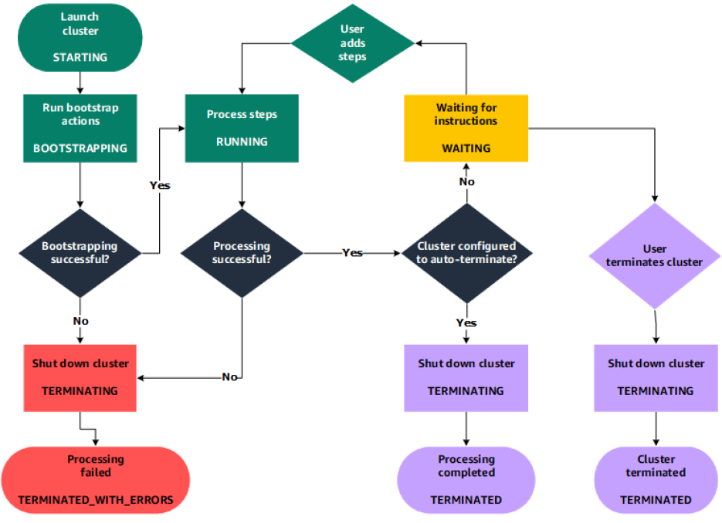
Cluster lifecycle
Creating a cluster (it takes ~10 minutes)
A cluster cannot be stopped
It can only be terminated

Slide 52
Cluster lifecycle
STARTING: EMR provisions EC2 instances for each required instance
BOOTSTRAPPING: EMR runs actions that you specify on each instance
E.g., install custom applications and perform customizations
Amazon EMR installs the native applications
E.g., Hive, Hadoop, Spark, and so on
RUNNING: a step for the cluster is currently being run
Cluster sequentially runs any steps that you specified when you created the cluster
WAITING: after steps run successfully
TERMINATING: after manual shut down
Any data stored on the cluster is deleted

Slide 53
Cluster: EMR
A step is a user-defined unit of processing
E.g., one algorithm that manipulates the data
Step states
PENDING: The step is waiting to be run
RUNNING: The step is currently running
COMPLETED: The step completed successfully
CANCELLED: The step was cancelled before running because an earlier step failed
FAILED: The step failed while running

Slide 54
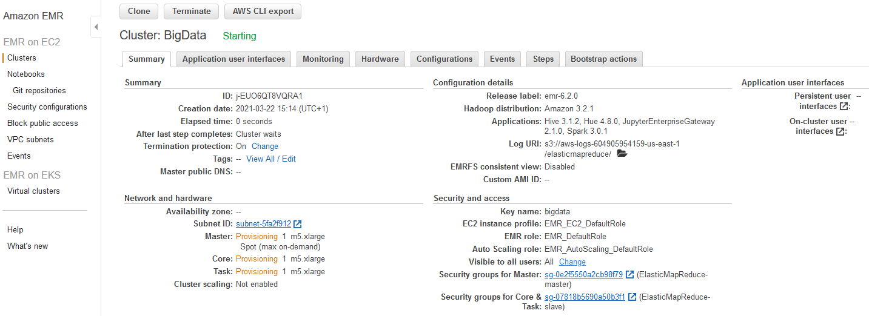
Running the cluster

Slide 55
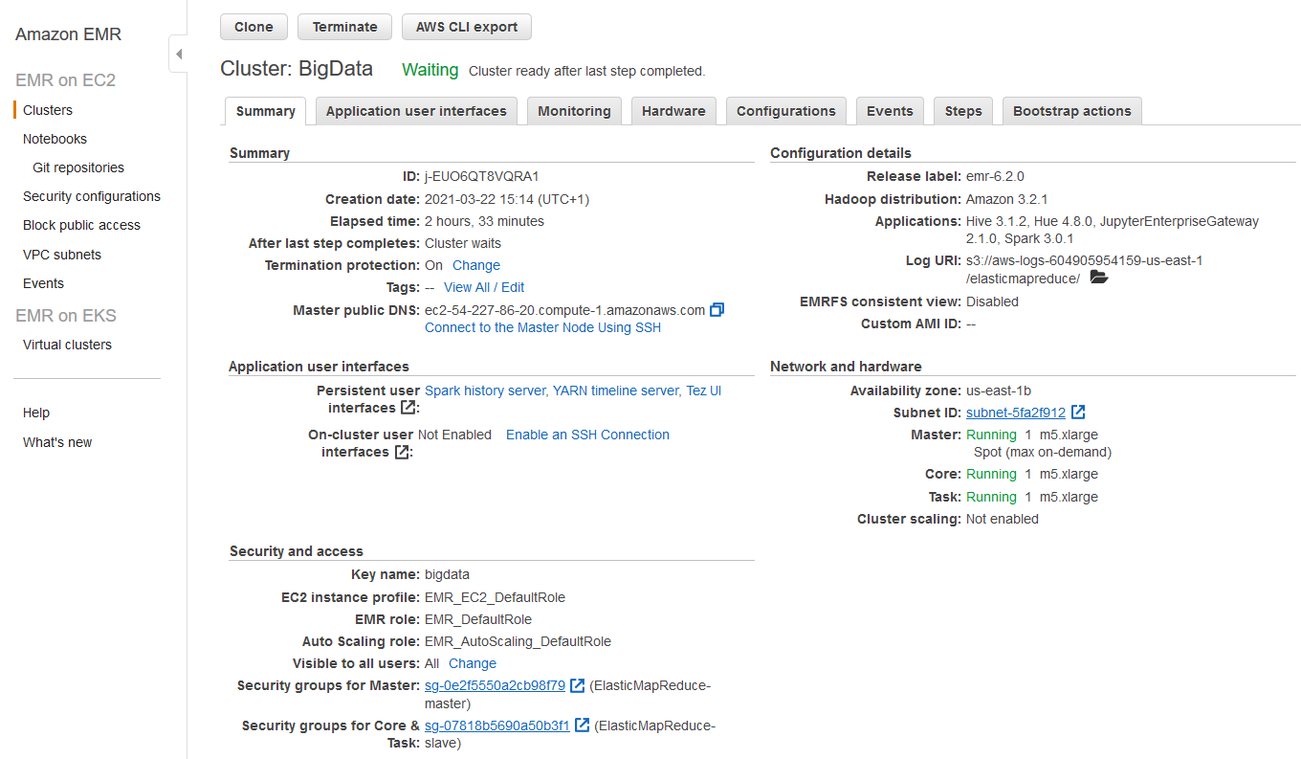
Running the cluster
DNS name

Slide 56
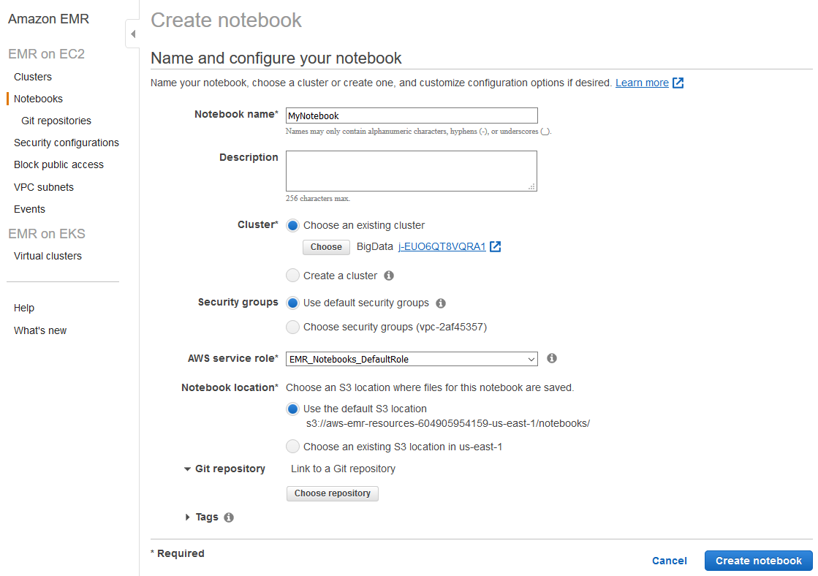
Creating a notebook

Slide 57
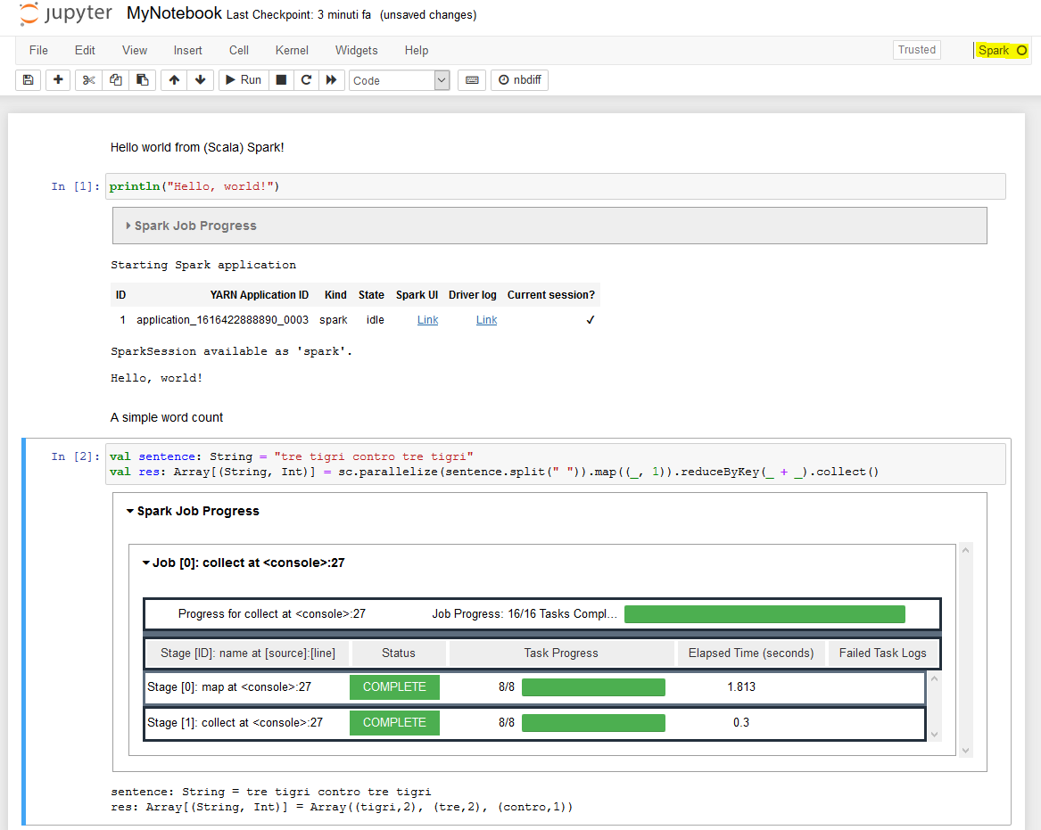
Hello, world!

Slide 58
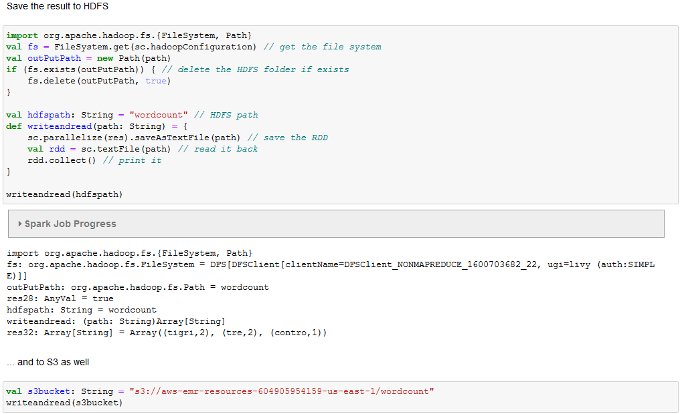
Add some storage

Slide 59
Running a Spark Job
Connect using SSH
Install git
Clone & build the project
ssh -i ~/bigdata.pem hadoop@ec2-54-242-176-32.compute-1.amazonaws.com
sudo yum install git -y
git clone https://github.com/w4bo/spark-word-count.git
cd spark-word-count
./gradlew
spark-submit --class it.unibo.big.WordCount build/libs/WordCount-all.jar s3://aws-bucket-bigdata2021/inferno.txt

Slide 60
Other services: HUE
Connecting to Hue
I.e., connecting to any HTTP interface hosted on the master node of a cluster
To view the Hue web user interface
Set Up an SSH Tunnel to the Master Node Using Dynamic Port Forwarding
Type the following address in your browser to open the Hue web interface
http://master-public-DNS:8888
Where master-public-DNS is the public DNS name of the master node
If you are the administrator logging in for the first time
Enter a username and password to create your Hue superuser account
Otherwise, type your username and password and select Create account

Slide 61
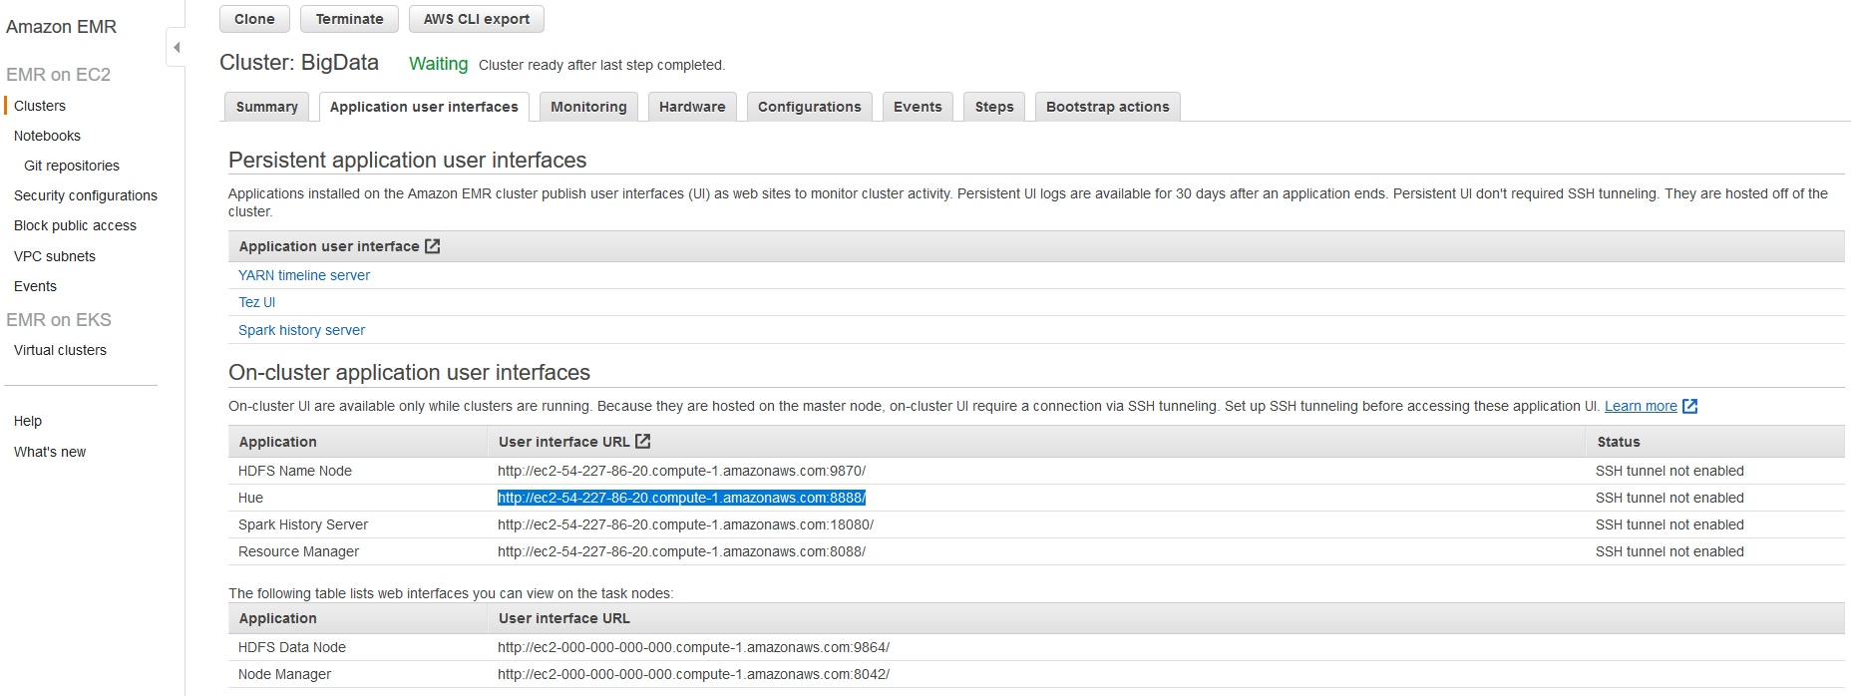
Other services: HUE

Slide 62
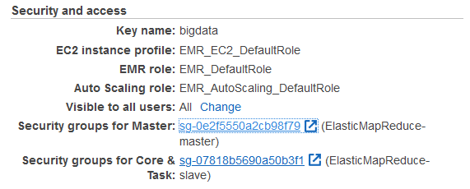
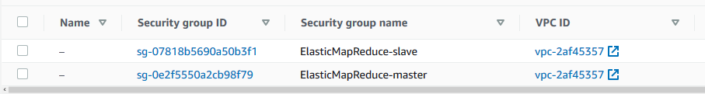
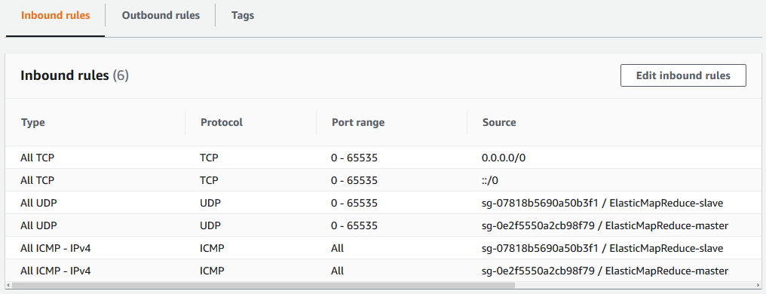
Set Up an SSH Tunnel

Slide 63
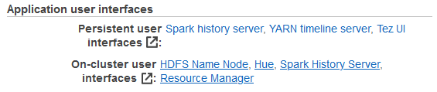
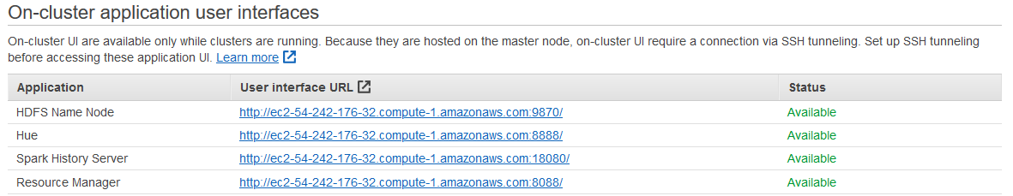
Connect to HUE

Slide 64
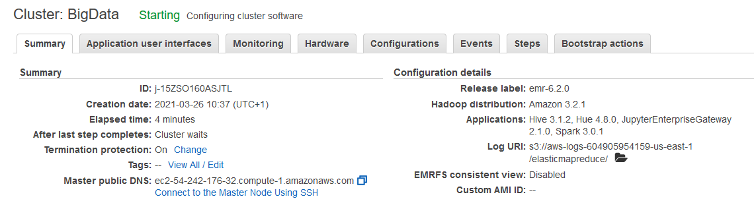
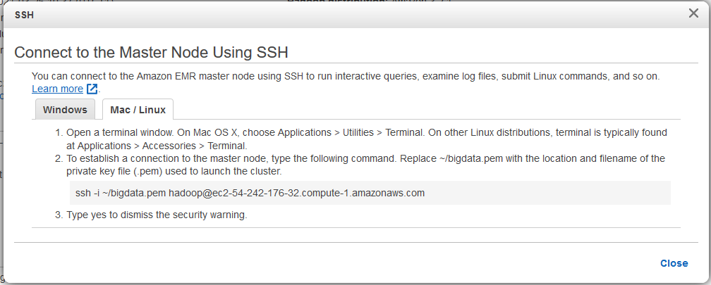
Connect using SSH

